Slide 1
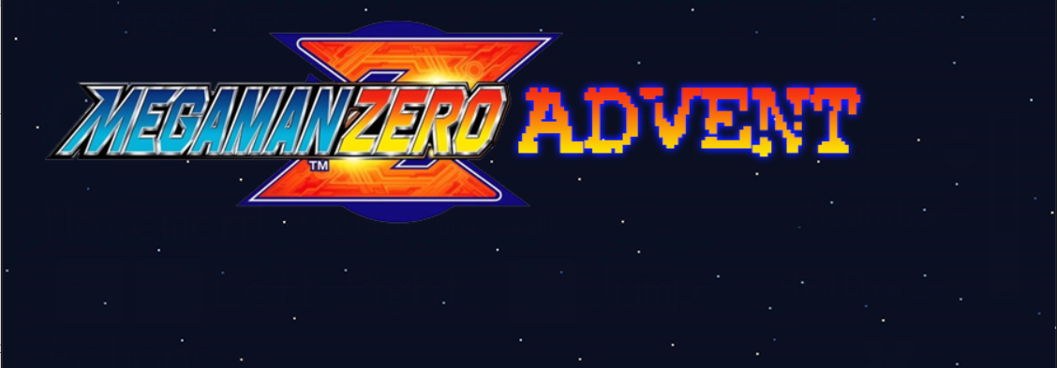

Megaman Run
Untapped Potential

Slide 2
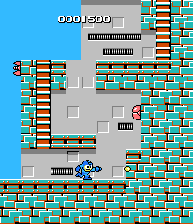
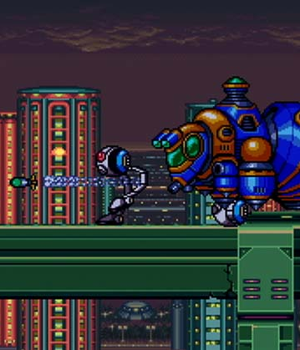
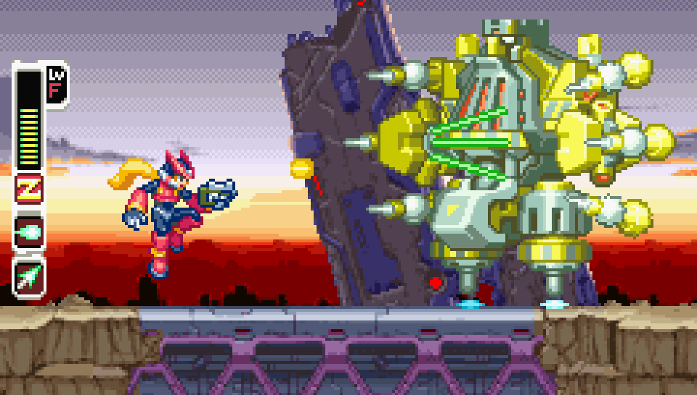
Product
Megaman Mobile App Similar to Mario Run
Simple Side Scroller with the options to shoot or jump
Implements multiple types of Megaman for a variety of play styles
Levels are to be added every week/month
Worldwide scoreboards kept to create competition

Slide 3
Target Market
Mainly teens interested in playing a mobile version of Megaman
Fans of Capcom’s Megaman series (goes up to age 30)
Use consumers nostalgia towards the game to our advantage

Slide 4
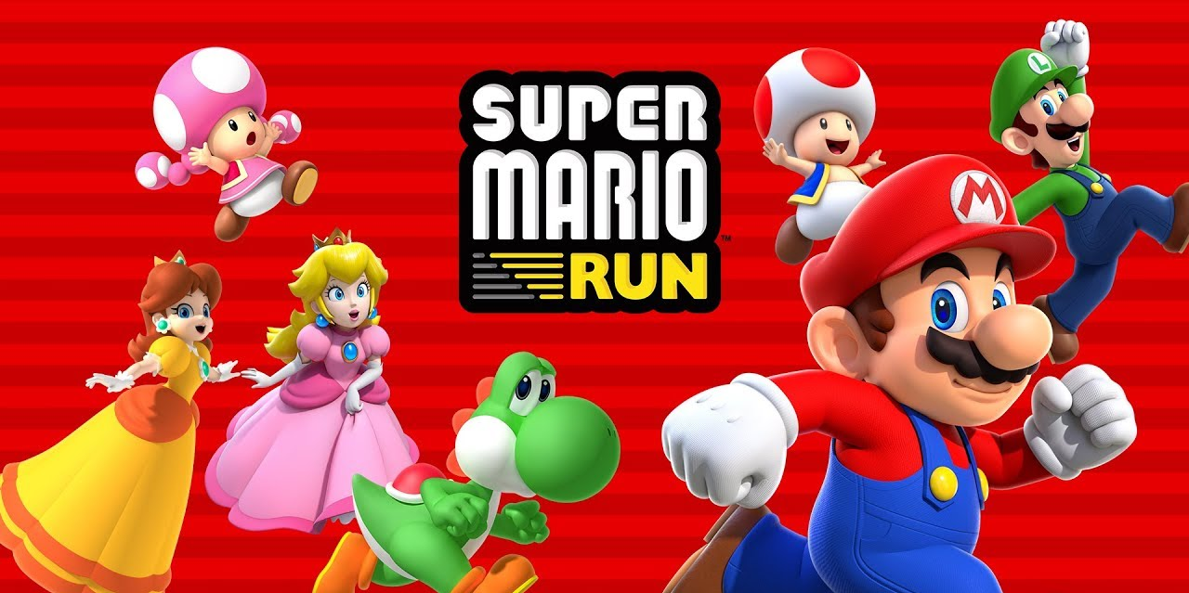
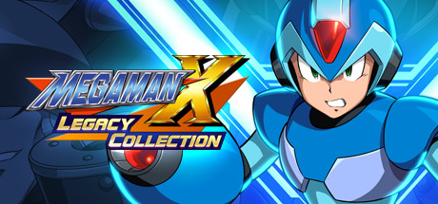
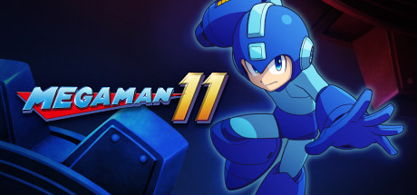
Key Benefits
Easy to promote using nostalgia
Megaman X Legacy and Megaman 11 both almost hitting 1 Million copies sold
Simple to create with existing Megamans
Strategy has been proven successful with Mario Run
Mario Run has generated more than $60 Million USD to date

Slide 5

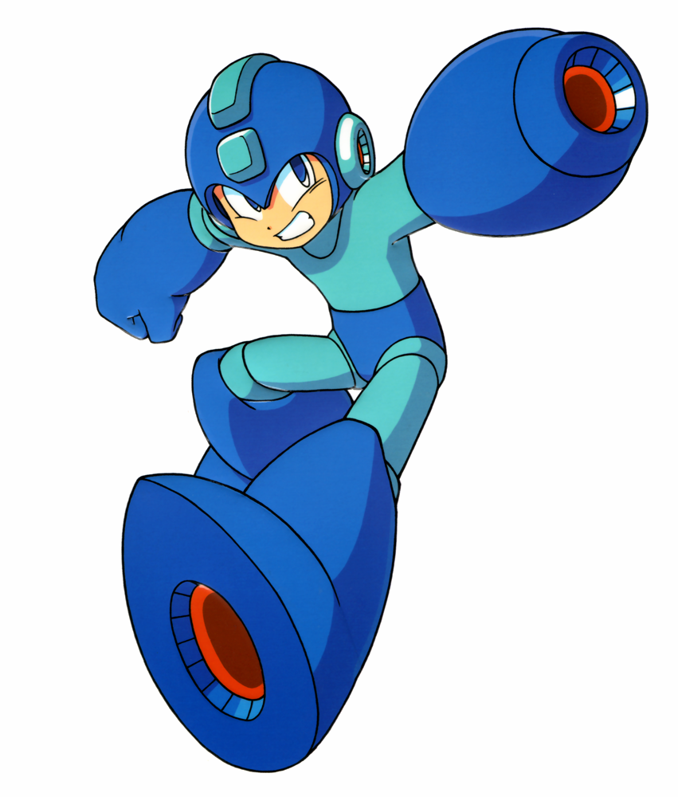
Next Steps
Get legal rights to allow the development of this game
Create a proper prototype to pitch
Advertise and generate hype for the game

Slide 6

Moving on to the Current Prototype!

